Slide 1

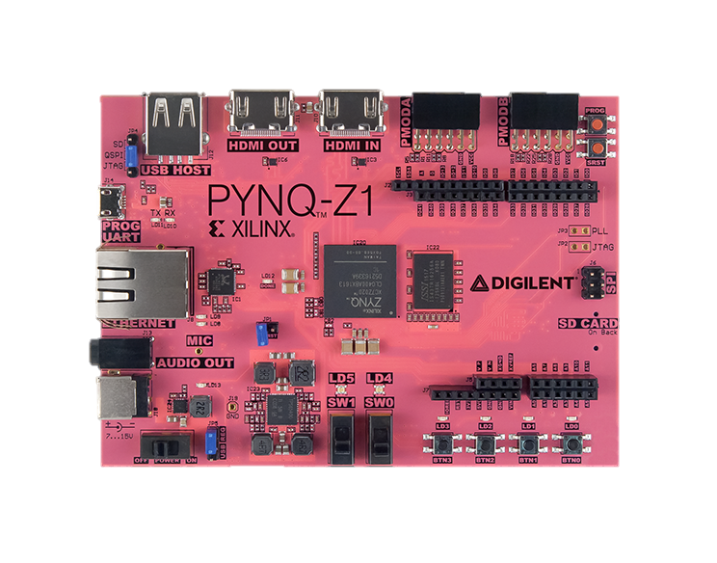
Rendering Fractals using the PYNQ Framework on FPGAs
PYNQ: Python Productivity for Zynq
Zynq Systems on Chip integrate an ARM processor with FPGA logic
Hardware “overlay” design is used to program the FPGA part of Zynq
Python API interacts with overlay
4th year CES | Student: | Filip Lejhanec
EE475 Project | 1st Supervisor: | Dr Louise Helen Crockett
2018/2019 | 2nd Supervisor: | Dr Alexandra Coddington

Slide 2
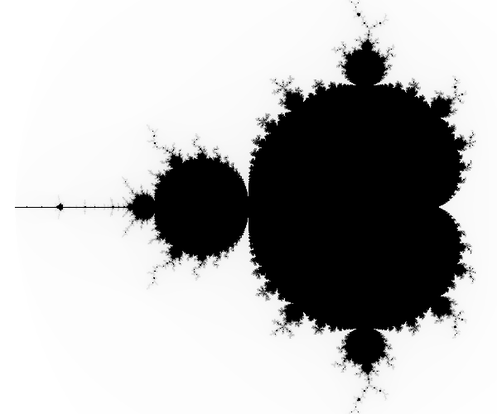
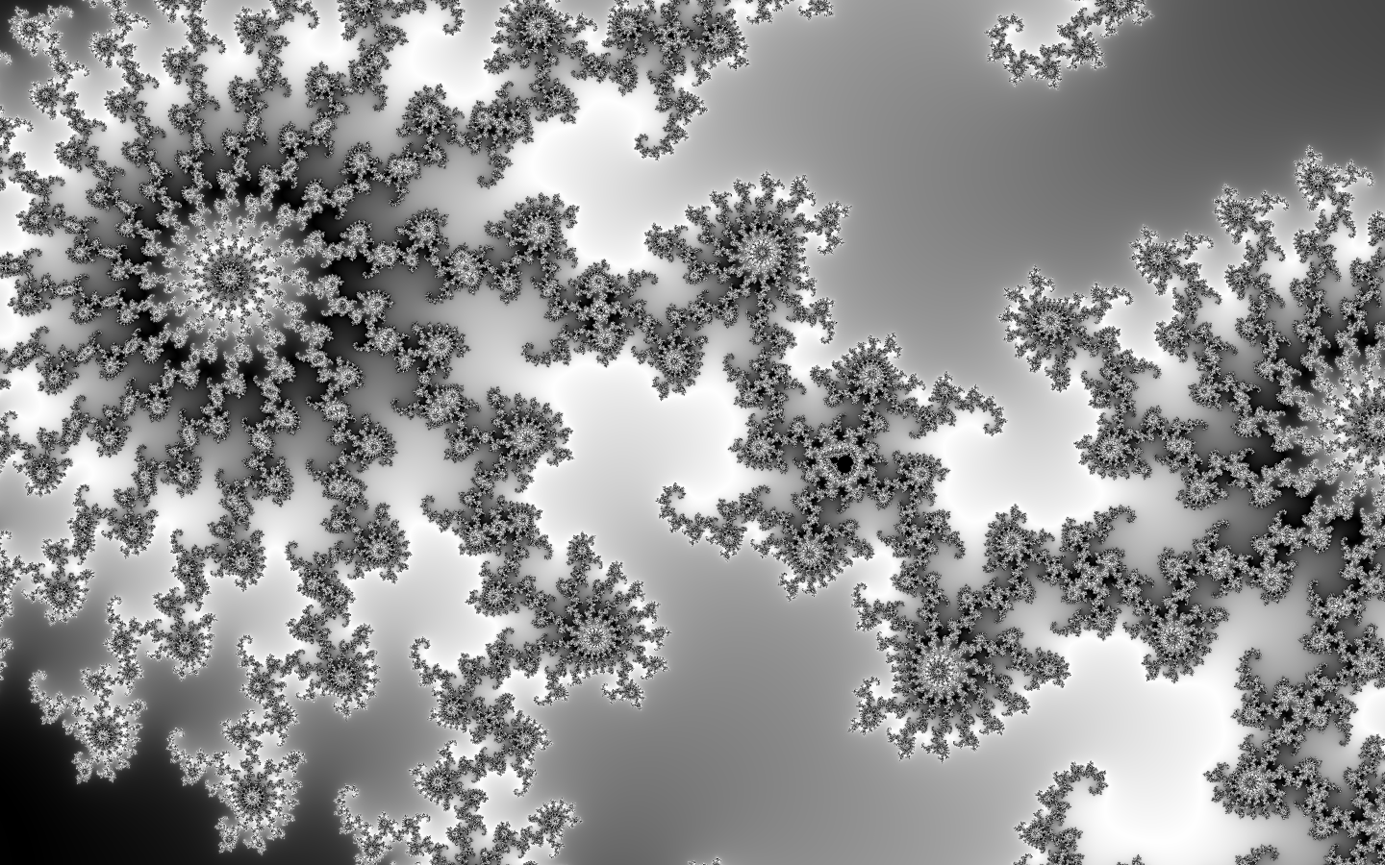
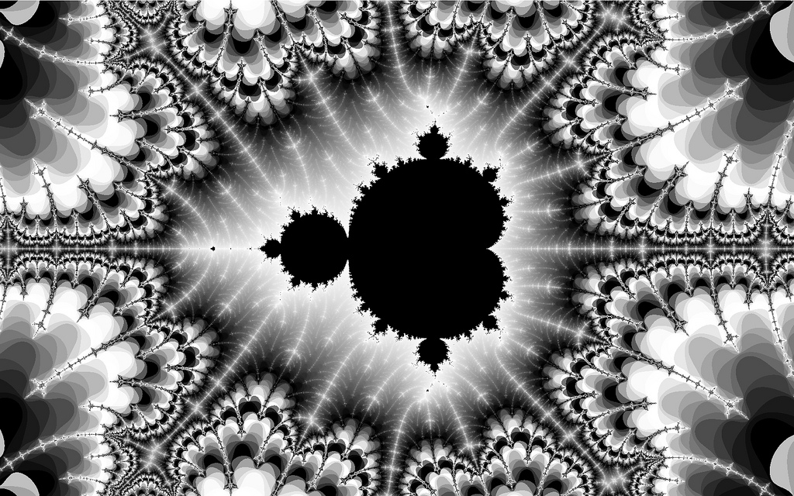
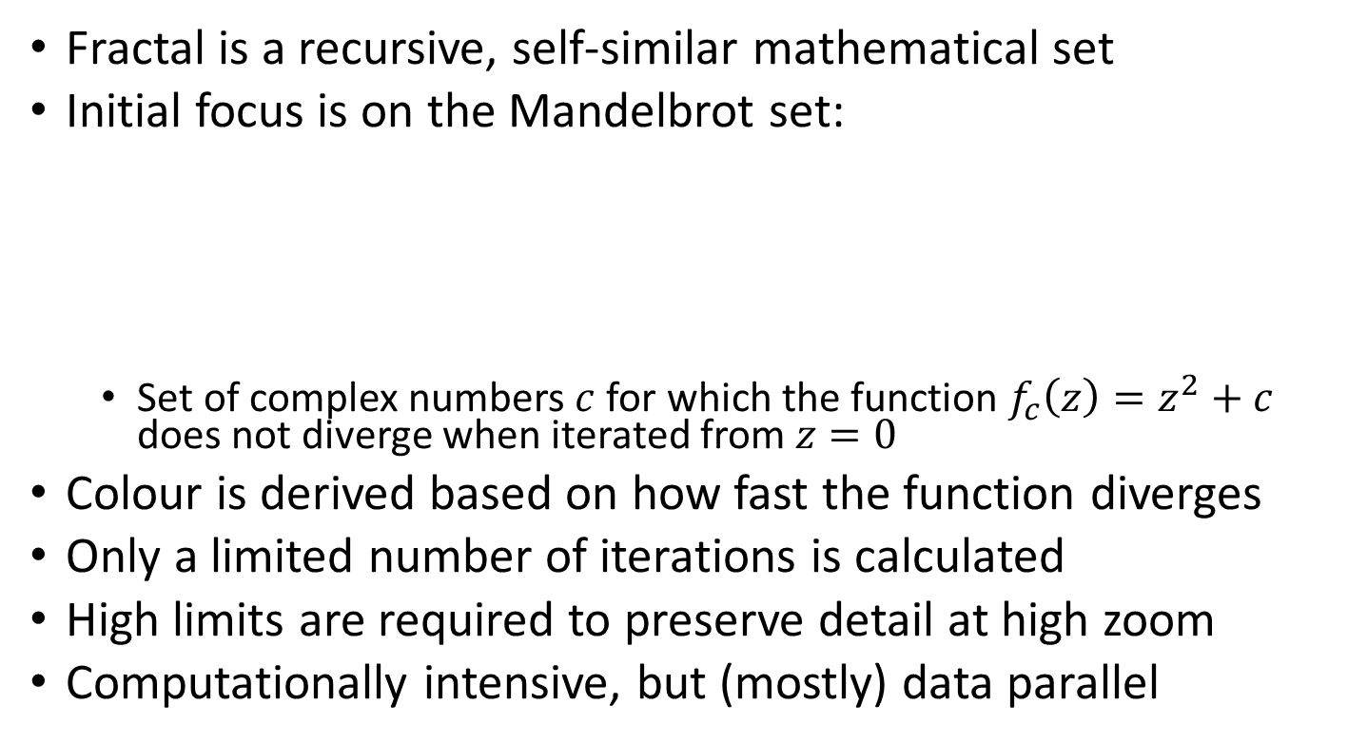
Overview of the Problem
Fractal is a recursive, self-similar mathematical set
Initial focus is on the Mandelbrot set:
Set of complex numbers $c$ for which the function $f_{c}\left(z\right)=z^{2}+c$ does not diverge when iterated from $z=0$
Colour is derived based on how fast the function diverges
Only a limited number of iterations is calculated
High limits are required to preserve detail at high zoom
Computationally intensive, but (mostly) data parallel

Slide 3


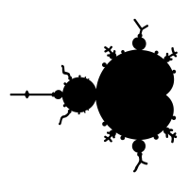
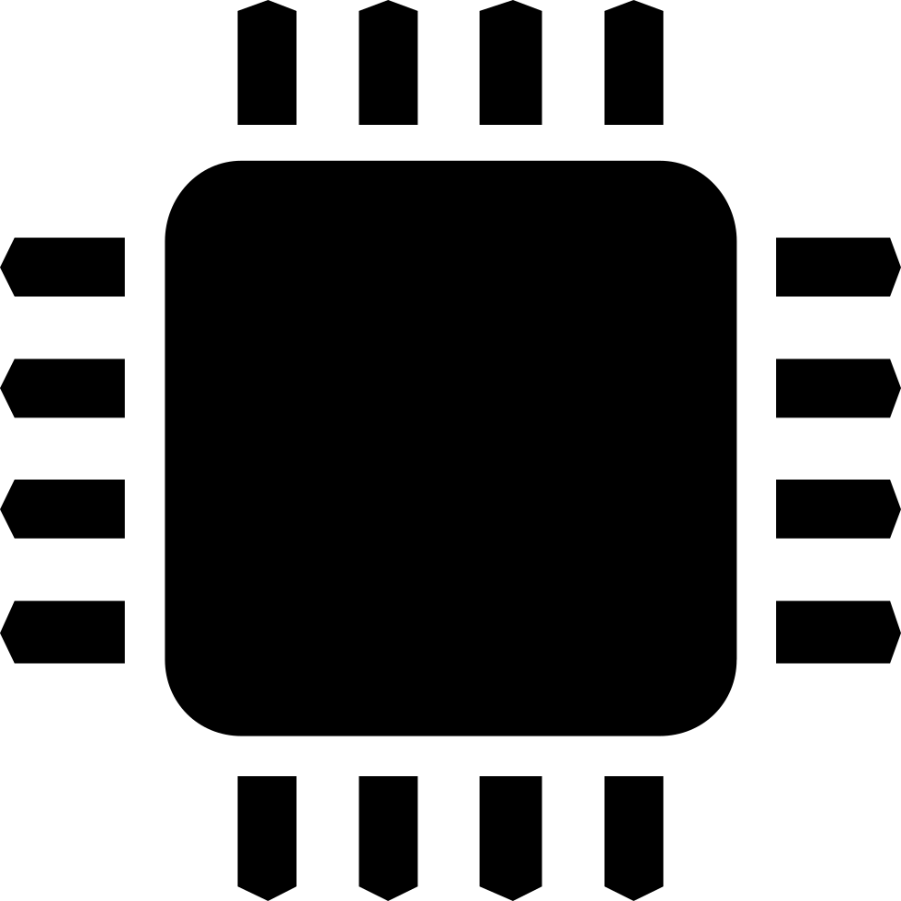

System Architecture
Zynq Processing System
AXI Interconnect
Mandelbrot HW block
Configuration
Image size
Coordinates
Scale
AXI Interrupt Controller
Notify when Finished Processing
AXI Stream MM2S
AXI Video Direct Memory Access
AXI Stream S2MM
Read Pixel Data
Store Pixel Data

Slide 4
Results & Accomplishments
Understanding of Mandelbrot fractal and PYNQ design processes
Full Python solution for both Desktop and PYNQ-Z1 board
High Level Synthesis solution with basic optimisation to build on
Modular system design for easy implementation of other fractals
Complete overlay design with PoC low-level Python drivers
Full render using only FPGA
Steady speed improvements
ip.write(0x10,1920)
ip.write(0x18,1080)
ip.write(0x20,struct.pack('d', 0.35))
ip.write(0x2c,struct.pack('d', 0.2))
ip.write(0x38,struct.pack('d', -1.3))
ip.write(0x44,struct.pack('d', 0.35))
ip.write(0x50,1000)
ip.write(0x00,1)
SW | HW
00:04:55 | 00:02:11

Slide 5
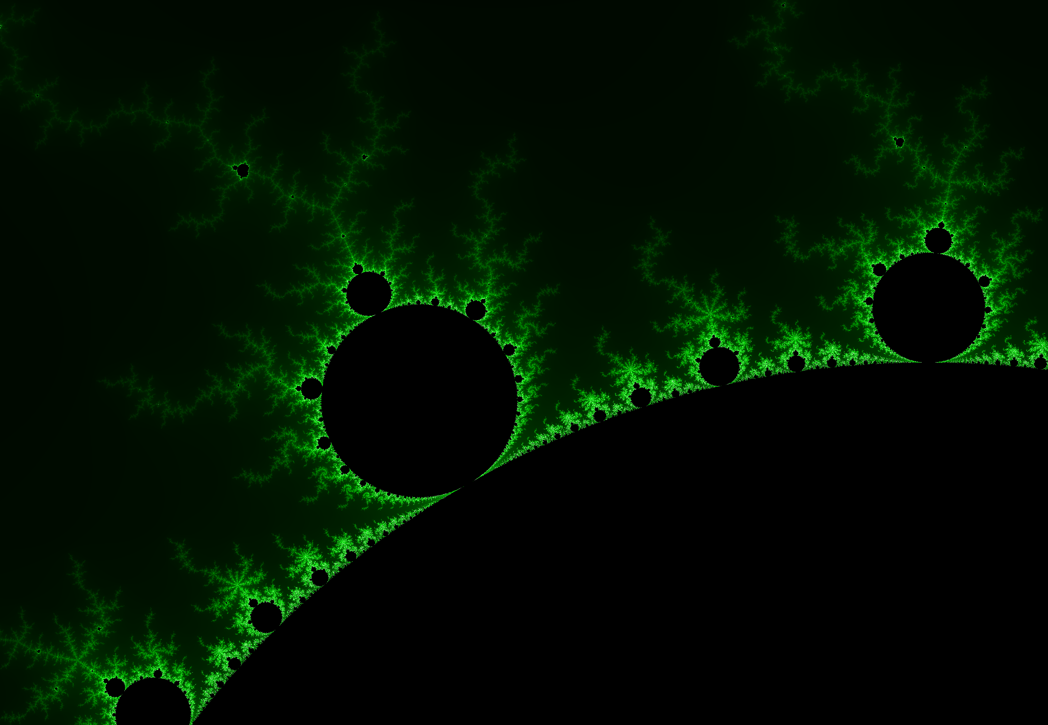
Full Render on the FPGA

Slide 6
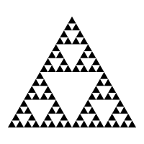
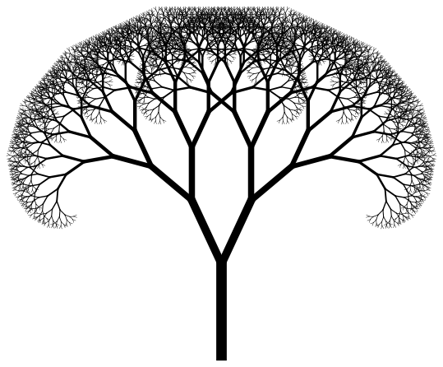
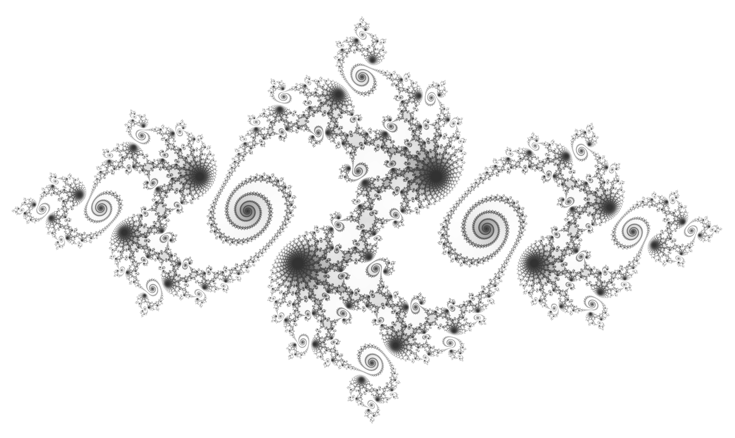
Interim Conclusion
Progress Reflection
Future Plans & Next Steps
PYNQ-Z1 seems like a perfect fit for the problem at hand
Key objectives completed
HW accelerated solution is already much faster than SW
Big room for optimisation
Very good progress so far
Most challenges resolved
Start working on stretch goals
Optimisation & efficiency
Parallelisation
Proper Custom drivers
Real-time interaction
More fractals

